Slide 1




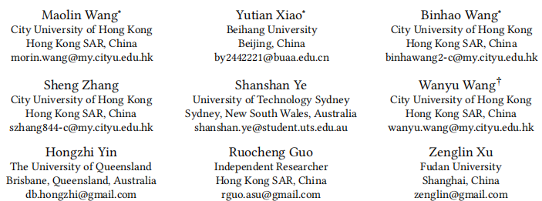





ATAI
Advanced Technique of Artificial Intelligence
ATAI
ChongqingUniversity _{AdvancedTechniqueof}
of Technology Artificial Intelligence
Chongqing University of Technology
Chongqing University ^{ATAI}
_{of Technology} Advanced Techniqueof
Artificial Intelligence
Chongqing University of Technology
Chongqing University of Technology
FindRec Stein-Guided Entropic Flow for Multi-Modal Sequential Recommendation
code: https://github.com/Applied-Machine-Learning-Lab/FindRec
—— KDD ’25
Reported by Junsi Chen
1

Slide 2

ATAI
AdvancedTechniqueof
Artificial Intelligence
ATAI
ChongqingUniversity _{AdvancedTechniqueof}
of Technology Artificial Intelligence
ChongqingUniversity of Technology
Motivation
1) Modern recommendation systems face significant challenges in processing multimodal sequential data, particularly in temporal dynamics modeling and information flow coordination. Traditional approaches struggle with distribution discrepancies between hetero-geneous features and noise interference in multimodal signals.
2) Traditional recommendation systems face several challenges :(1)relying solely on item IDs fails to capture rich multimodal information that influences user preferences, (2) existing multimodal fusion approaches often treat different modalities independently, leading to suboptimal feature interactions, and (3) modeling complex temporal dependencies in sequential user behaviors remains difficult, especially when integrating multimodal signals.

Slide 3

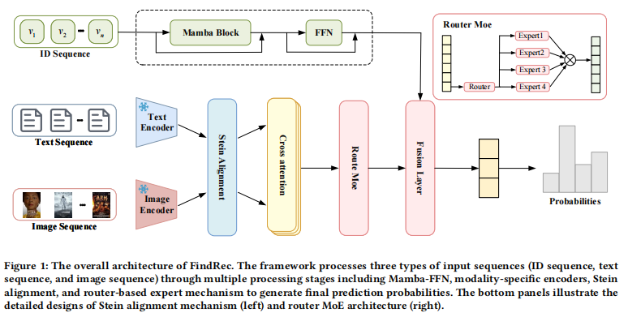
ChongqingUniversity of Technology
ATAI
AdvancedTechniqueof
Artificial Intelligence
ATAI
ChongqingUniversity _{AdvancedTechniqueof}
of Technology Artificial Intelligence
Overview

Slide 4
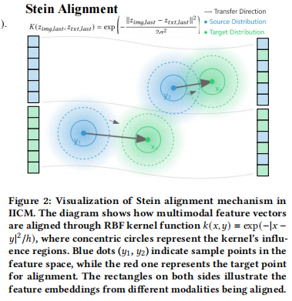
ChongqingUniversity of Technology
ATAI
AdvancedTechniqueof
Artificial Intelligence
ATAI
ChongqingUniversity _{AdvancedTechniqueof}
of Technology Artificial Intelligence
Overview

Slide 5




ChongqingUniversity of Technology
ATAI
AdvancedTechniqueof
Artificial Intelligence
ATAI
ChongqingUniversity _{AdvancedTechniqueof}
of Technology Artificial Intelligence
Method
(1)
(2)
(3)
(4)
(5)

Slide 6

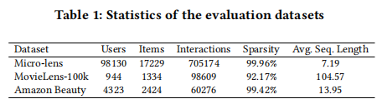
ATAI
Advanced Technique of Artificial Intelligence
ATAI
ChongqingUniversity _{AdvancedTechniqueof}
of Technology Artificial Intelligence
Chongqing University of
Technology
Chongqing University ^{ATAI}
_{of Technology} Advanced Techniqueof
Artificial Intelligence
Chongqing University of Technology
Chongqing University of Technology

Slide 7
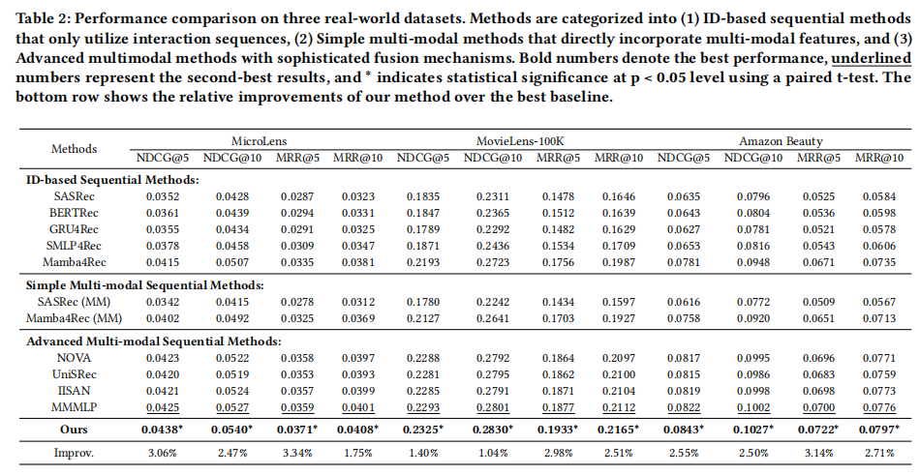
ATAI
Advanced Technique of Artificial Intelligence
ATAI
ChongqingUniversity _{AdvancedTechniqueof}
of Technology Artificial Intelligence
Chongqing University of
Technology
Chongqing University ^{ATAI}
_{of Technology} Advanced Techniqueof
Artificial Intelligence
Chongqing University of Technology
Chongqing University of Technology

Slide 8
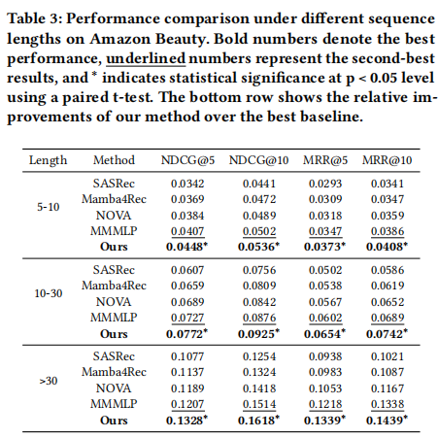
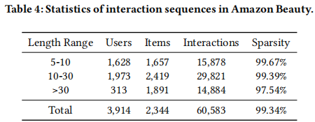
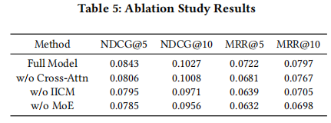
ATAI
Advanced Technique of Artificial Intelligence
ATAI
ChongqingUniversity _{AdvancedTechniqueof}
of Technology Artificial Intelligence
Chongqing University of
Technology
Chongqing University ^{ATAI}
_{of Technology} Advanced Techniqueof
Artificial Intelligence
Chongqing University of Technology
Chongqing University of Technology

Slide 9
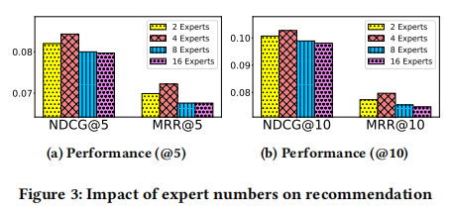
ATAI
Advanced Technique of Artificial Intelligence
ATAI
ChongqingUniversity _{AdvancedTechniqueof}
of Technology Artificial Intelligence
Chongqing University of
Technology
Chongqing University ^{ATAI}
_{of Technology} Advanced Techniqueof
Artificial Intelligence
Chongqing University of Technology
Chongqing University of Technology

Slide 10


ATAI
Advanced Technique of
Artificial Intelligence
ATAI
ChongqingUniversity _{AdvancedTechniqueof}
of Technology Artificial Intelligence
Chongqing University of Technology
Thanks!

